Slide 1
Basic statistics

Slide 2
Statistics
Collecting
Classifying
Summarizing
Analyzing
Interpreting numerical information
Statistics is used to find meaningfull trend and info and make logical decisions. statistics is the building block of the analytics and machine learning algorithms.

Slide 3
DATA = INFORMATION(useful/trash)
SAMPLE DATA --- It is the subset of data that is extracted from the given Population.
POPULATION DATA --- It is the set of the given sources from which the sample data has to be collected. There can be a huge number of population.

Slide 4
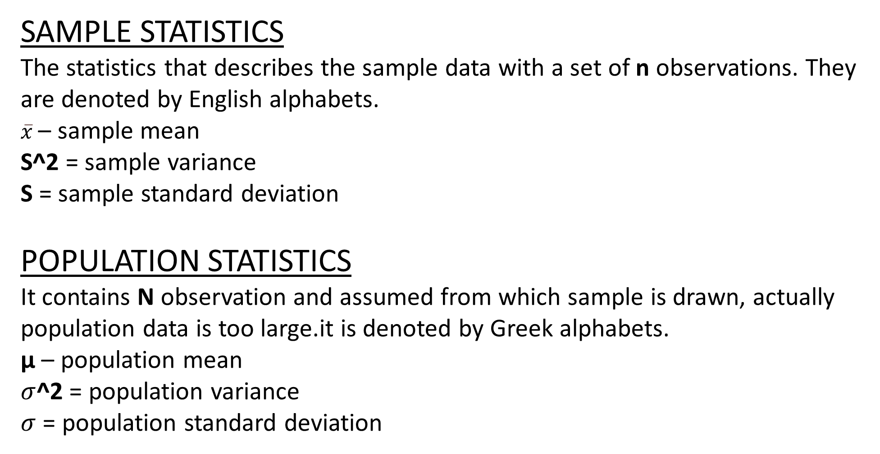
SAMPLE STATISTICS
The statistics that describes the sample data with a set of n observations. They are denoted by English alphabets.
$\overline{x}$ – sample mean
S^2 = sample variance
S = sample standard deviation
POPULATION STATISTICS
It contains N observation and assumed from which sample is drawn, actually population data is too large.it is denoted by Greek alphabets.
µ – population mean
$σ$^2 = population variance
$σ$ = population standard deviation

Slide 5
Statistics has two types.
Descriptive statistics describes data (for example, a chart or graph) and inferential statistics allows you to make predictions (“inferences”) from that data. With inferential statistics, you take data from samples and generalize about a population.
The main goal of inferential statistics is to make a conclusion about a population based on sample data from the population.one of the most famous techniques is Hypothesis testing.

Slide 6
DATA TYPES
NOMINAL
ORDINAL
INTERVAL
RATIO
DATA TYPES IN GENERAL
CONTINUOUS
DISCRETE
DATA :
NUMERICAL
CATEGORICAL

Slide 7
MEASURES OF CENTRAL TENDANCY
It is a single value that attempts to describe a set of data by identifying the central position within that set of data.
Mean: Means stands for the average of the given data .
Median: Median is the middle of the given ordered data (ascending/descending).
Mode: Mode is the most repeated value in a given data . It is the only relevant for discrete data.

Slide 8
MEASURE OF VARIALBILITY
It is a summary statistic that represents the amount of dispersion in a dataset and how far data points tend to fall from the other.
Deviation =distance from the mean.
Deviation score = observation – true mean.
Variance = average of squared deviation scores. Variance measures how spread out a set of the given data is relative to the mean.
Standard deviation = square root of variance. It is also a measurement of how spread-out numbers are in the given data set
Range = difference between maximum and minimum value in data set.

Slide 9
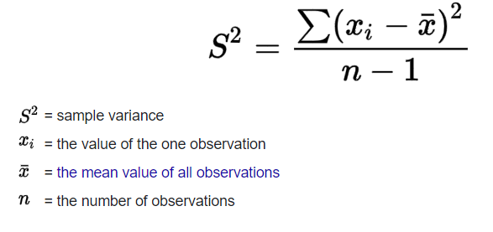
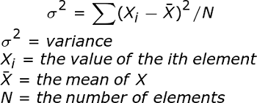
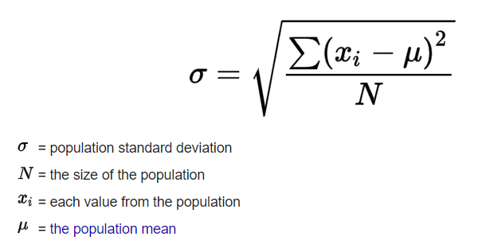
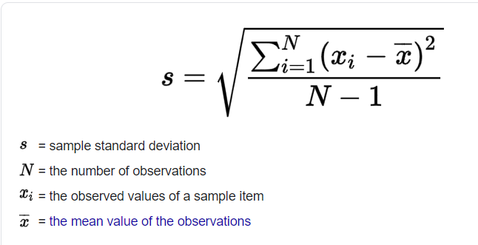

Slide 10
Bessel's correction is the use of n − 1 instead of n in the formula for the sample variance and sample standard deviation, where n is the number of observations in a sample. This method corrects the bias in the estimation of the population variance. It also partially corrects the bias in the estimation of the population standard deviation. However, the correction often increases the mean squared error in these estimations

Slide 11
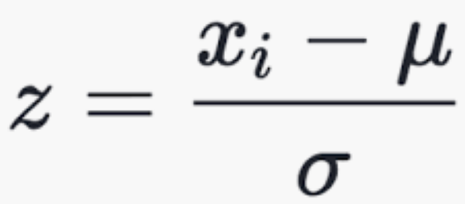
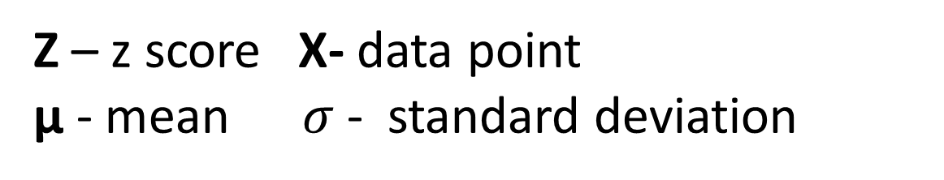
Z-scores
Z score determines the number of standard deviations a data point is from the mean.
Z – z score X- data point
µ - mean $σ$ - standard deviation
The z-score in the center of the curve is zero. The z-scores to the right of the mean are positive and the z-scores to the left of the mean are negative.

Slide 12
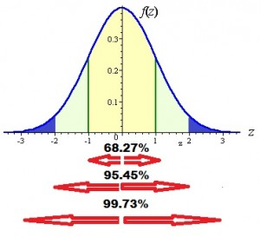
Z scores can be calculated by z-table, z-score formulae or python function for z score.
graph can tell us the area under the curve for one (z = -1 to 1), two (z = -2 to 2) and three (z = -3 to 3) standard deviations from the center.

Slide 13
PROBABILITY DISTRIBUTION
A probability distribution is a statistical function that describes all the possible values and likelihoods that a random variable can take within a given range.
Sum of all the probabilities in a distribution sums to 1.
Each value has a probability between 0 to 1.
CONTINUOUS PROBABILITY DISTRIBUTIONS
Probability distribution where random variable X is continuous data. Example: normal distribution(gaussian dist)
DISCRETE PROBABILITY DISTRIBUATIONS
A discrete probability distribution is where the set of possible outcomes is discrete (e.g. a coin toss, a roll of a dice), and the probabilities are here encoded by a discrete list of the probabilities of the outcomes, known as the probability mass function.

Slide 14
Continuous Data Distributions
Continuous Distribution: Continuous data distributions are a probability distribution. In this distribution all the outcomes are equally likely.
Normal/Gaussian Distribution: The normal distribution is commonly referred to as the bell curve. In addition it is also related to the central limit theorem. It has the standard deviation of 1 and the mean is 0.

Slide 15
T-Distribution: The T distribution is another probability distribution. It is used to estimate population parameters when the sample size is small.
Uniform Distribution: In this probability distribution we have the single value that only occurs within the certain range. The value outside this range is just 0. It is also known as on and off distribution.
Position Distribution: It is quite similar to the normal distribution. But it offers the addition factor i.e. the skewness. The lower the value of the skewness the distribution will relatively uniformly spread in all directions. But if the skewness is high then the data will spread out in different directions with unequal distribution.

Slide 16
Discrete Data Distributions
Poisson Distribution: One of the most common probability distributions. It expresses the probability of a given number of events occurring within a given fixed time period.
Binomial Distribution: The probability distribution of the number of successes in a sequence of n independent experiences each with its own Boolean-valued outcome (p, 1-p).

Slide 17
CENTRAL LIMIT THEOREM
The central limit theorem states that if you have a population with mean μ and standard deviation σ and take sufficiently large random samples from the population with replacement , then the distribution of the sample means will be approximately normally distributed.

Slide 18
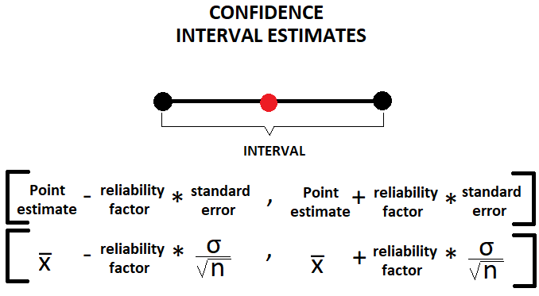
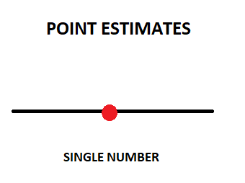
Confidence interval
A Confidence Interval is a range of values we are fairly sure our true value lies in.since point estimates could give error, we use to specify a range instead of single point.(assume normal distribution) Z α/2 — Reliability factor, if we assume a confidence level of 95% thus α=5%.

Slide 19
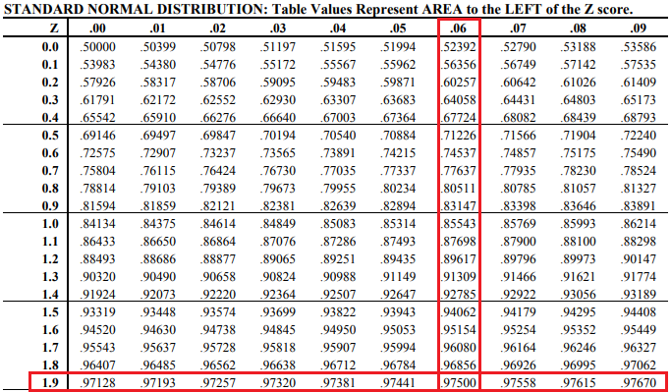
To get our reliability factor (Z α/2), we have to make use of the z-table for the standard Normal Distribution.
α = 0.05
Confidence = 95% of the cases the true population parameter would fall into the specified interval. reliability factor = Z 0.05/2 => Z 0.025.
In the table, the value will match the value of 1- α =1–0.025 = 0.975.
The corresponding Z comes with the sum of the table row and column associated with that cell.
Therefore, for our pratical case, the critical value (commonly used term for Z) for this confidence interval is Z 0.025 = 1.9+0.06 = 1.96.

Slide 20
STUDENT T – DISTRIBUTION
The T distribution (also called Student’s T Distribution) is a family of distributions that look almost identical to the normal distribution curve, only a bit shorter and fatter. The t distribution is used instead of the normal distribution when you have small samples .The larger the sample size, the more the t distribution looks like the normal distribution. In fact, for sample sizes larger than 20 (e.g. more degrees of freedom), the distribution is almost exactly like the normal distribution.

Slide 21
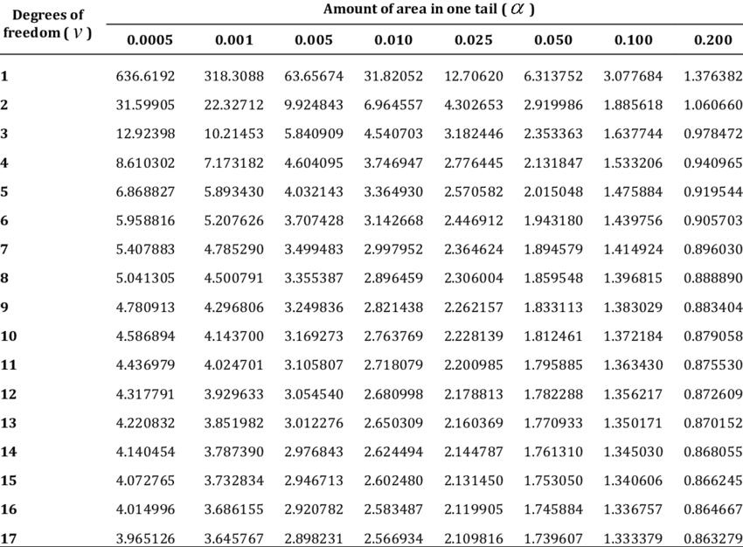
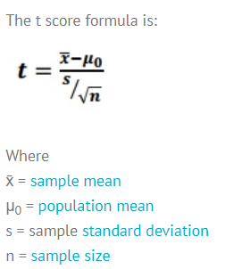

Slide 22
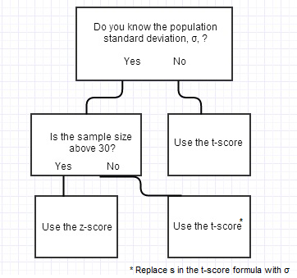

Slide 23
WHY WE NEED Z SCORE?
The standard score (more commonly referred to as a z-score) is a very useful statistic because it (a) allows us to calculate the probability of a score occurring within our normal distribution and (b) enables us to compare two scores that are from different normal distributions.
WHY WE NEED T SCORE?
The t‐distribution is used as an alternative to the normal distribution when sample sizes are small in order to estimate confidence or determine critical values that an observation is a given distance from the mean.

Slide 24
HYPOTHESIS TESTING
A hypothesis is an educated guess about something in the world around you. It should be testable, either by experiment or observation. For example:
A new medicine you think might work.
A way of teaching you think might be better.
A possible location of new species.
A fairer way to administer standardized tests.

Slide 25
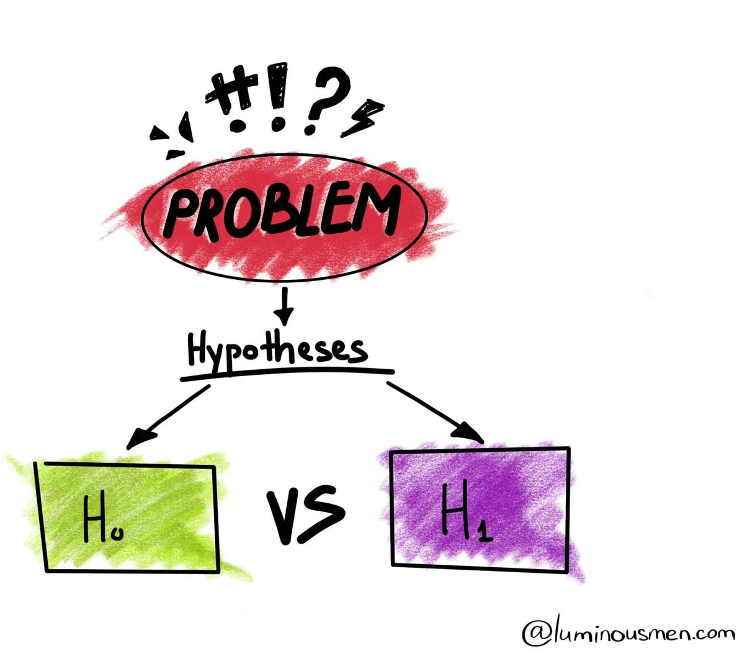
NULL HYPOTHESIS (HO):the statement given is false
ALTERNATIVE HYPOTHESIS(H1):the given statement is true
example: company A gives higher performance than company B.
HO = both give same performance.
H1 = given statement is true.

Slide 26
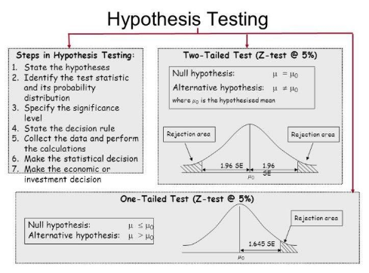

Slide 27
STEPS
State H0 and H1.
State Alpha level (0.05)
Choose what kind of test you need to perform,MEAN given z-test or else t-test.
Either support or reject the null hypothesis.
5.Drawing a Conclusion
P-value <= significance level (α) => Reject your null hypothesis in favor of your alternative hypothesis. Your result is statistically significant.
P-value > significance level (α) => Fail to reject your null hypothesis. Your result is not statistically significant.

Slide 28
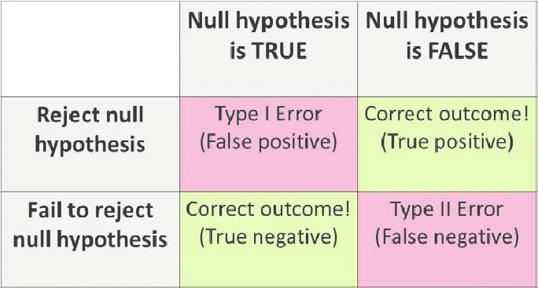
TYPES OF ERRORS IN HYPOTHESIS TESTING.

Slide 29
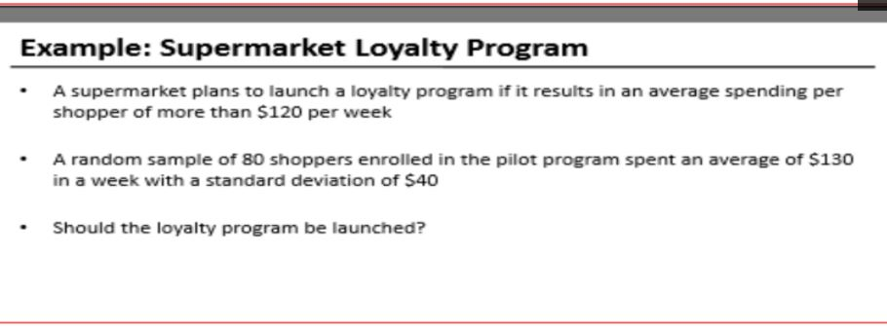

Slide 30
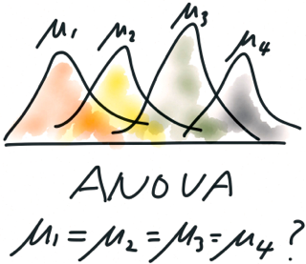
ANOVA TEST
Analysis of variance (ANOVA) is a statistical technique that is used to check if the means of two or more groups are significantly different from each other. ANOVA checks the impact of one or more factors by comparing the means of different samples.

Slide 31
F-Statistic
The statistic which measures if the means of different samples are significantly different or not is called the F-Ratio. Lower the F-Ratio, more similar are the sample means. In that case, we cannot reject the null hypothesis.
F = Between group variability / Within group variability
Unlike the z and t-distributions, the F-distribution does not have any negative values because between and within-group variability are always positive due to squaring each deviation.

Slide 32
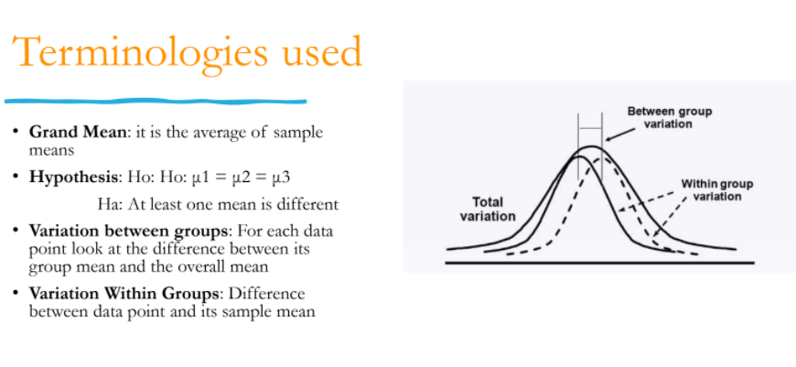
IF f statistics value is greater than f critical value, we reject HO.

Slide 33
SKEWNESS AND KURTOSIS
Skewness is a measure of symmetry, or more precisely, the lack of symmetry. A distribution, or data set, is symmetric if it looks the same to the left and right of the center point.
Kurtosis is a measure of whether the data are heavy-tailed or light-tailed relative to a normal distribution. That is, data sets with high kurtosis tend to have heavy tails, or outliers. Data sets with low kurtosis tend to have light tails, or lack of outliers. A uniform distribution would be the extreme case

Slide 34
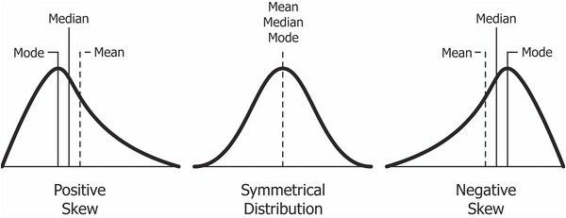

Slide 35
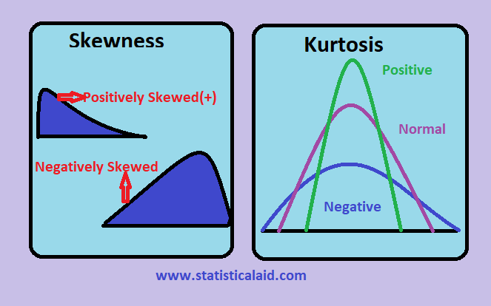

Slide 36
.
THANK YOU!

